Slide 1
Software Engineering
Sobia Iftikhar
Sobia.Iftikhar@nu.edu.pk
Week 12

Slide 2
Class 31 5th-May-2021

Slide 3
Software Testing
Development testing
Test-driven development
Release testing
User testing

Slide 4
Component testing
Software components are often composite components that are made up of several interacting objects.
For example, in the weather station system, the reconfiguration component includes objects that deal with each aspect of the reconfiguration.
You access the functionality of these objects through the defined component interface.
Testing composite components should therefore focus on showing that the component interface behaves according to its specification.
You can assume that unit tests on the individual objects within the component have been completed.

Slide 5
Interface testing
Objectives are to detect faults due to interface errors or invalid assumptions about interfaces.
Interface types
Parameter interfaces Data passed from one method or procedure to another.
Shared memory interfaces Block of memory is shared between procedures or functions.
Procedural interfaces Sub-system encapsulates a set of procedures to be called by other sub-systems.
Message passing interfaces Sub-systems request services from other sub-systems

Slide 6
Interface testing

Slide 7
Interface errors
Interface misuse
A calling component calls another component and makes an error in its use of its interface e.g. parameters in the wrong order.
Interface misunderstanding
A calling component embeds assumptions about the behaviour of the called component which are incorrect.
Timing errors
The called and the calling component operate at different speeds and out-of-date information is accessed.

Slide 8
Interface testing guidelines
Design tests so that parameters to a called procedure are at the extreme ends of their ranges.
Always test pointer parameters with null pointers.
Design tests which cause the component to fail.
Use stress testing in message passing systems.
In shared memory systems, vary the order in which components are activated.

Slide 9
System testing
System testing during development involves integrating components to create a version of the system and then testing the integrated system.
The focus in system testing is testing the interactions between components.
System testing checks that components are compatible, interact correctly and transfer the right data at the right time across their interfaces.
System testing tests the emergent behaviour of a system.

Slide 10
System and component testing
During system testing, reusable components that have been separately developed and off-the-shelf systems may be integrated with newly developed components. The complete system is then tested.
Components developed by different team members or sub-teams may be integrated at this stage. System testing is a collective rather than an individual process.
In some companies, system testing may involve a separate testing team with no involvement from designers and programmers.

Slide 11
Test-driven development

Slide 12
JUnit Testing
Create java class
Create Test class (JUnit class)
Add input value is Test Case with Expected output
See test fail and pass

Slide 13
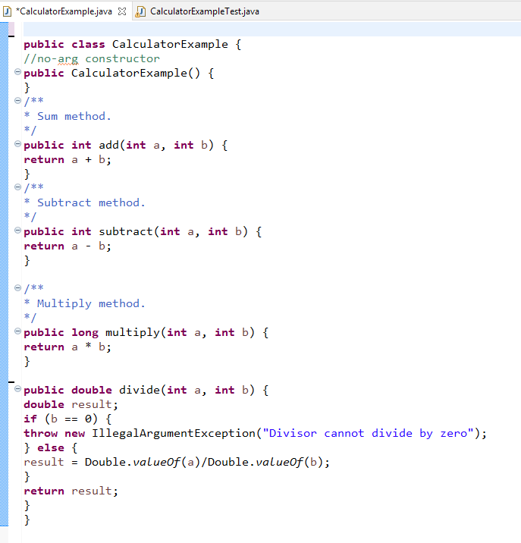
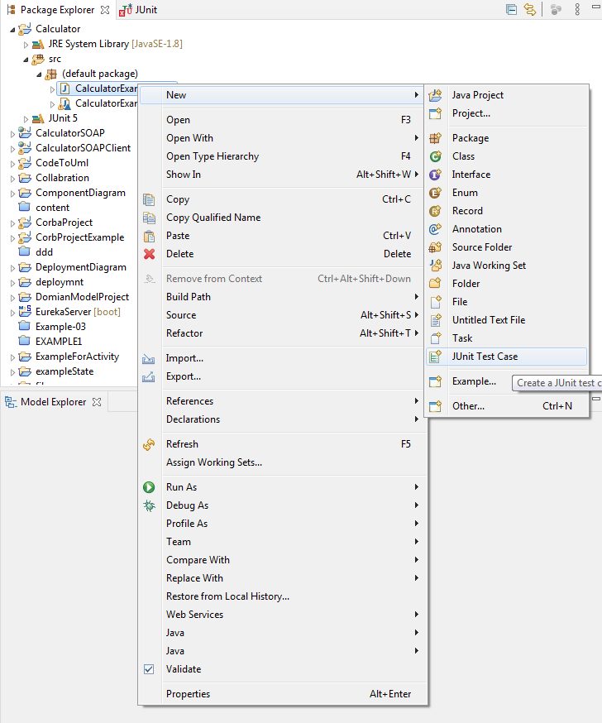
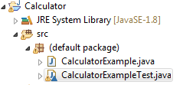

Slide 14
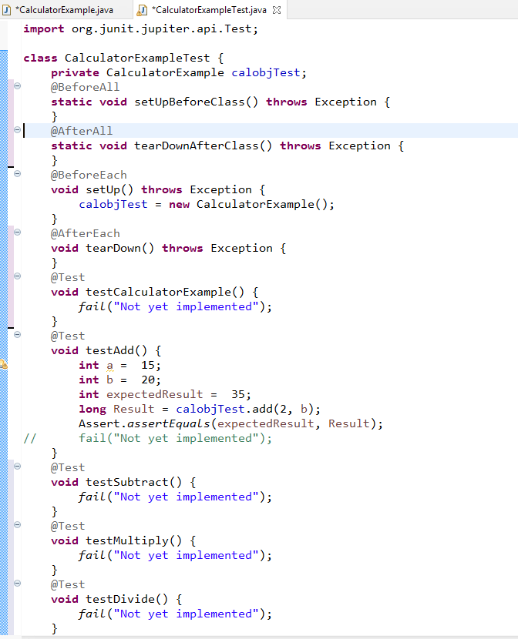
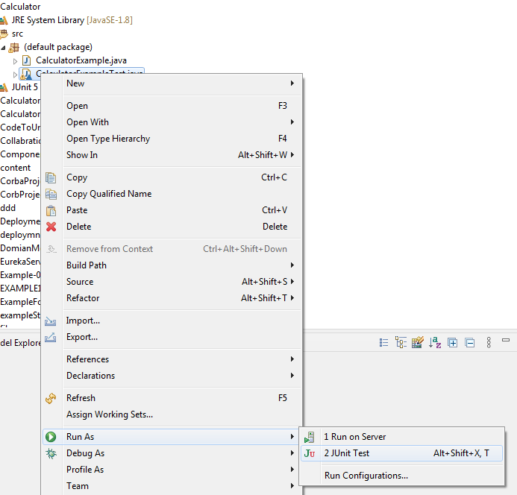
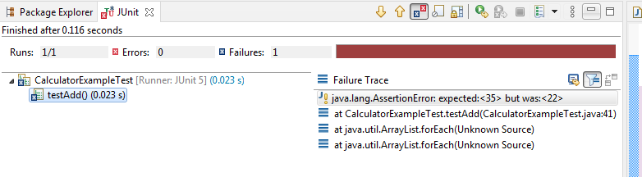

Slide 15
Test-driven development
Test-driven development (TDD) is an approach to program development in which you inter-leave testing and code development.
Tests are written before code and ‘passing’ the tests is the critical driver of development.
You develop code incrementally, along with a test for that increment. You don’t move on to the next increment until the code that you have developed passes its test.
TDD was introduced as part of agile methods such as Extreme Programming. However, it can also be used in plan-driven development processes.

Slide 16
Test-driven development

Slide 17
The fundamental TDD Process:
1. You start by identifying the increment of functionality that is required.
2. You write a test for this functionality and implement it as an automated test. This means that the test can be executed and will report whether or not it has passed or failed.
3. You then run the test, IF fail.
4. You then implement the functionality and re-run the test. This may involve refactoring existing code to improve it and add new code to what’s already there.
5. Once all tests run successfully, you move on to implementing the next chunk of functionality.

Slide 18
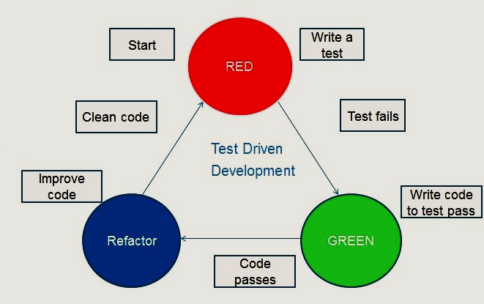
TDD-Cycle

Slide 19
Example
If you don’t know enough to write the tests, you won’t develop the required code.
For example, if your computation involves division, you should check that you are not dividing the numbers by zero.
If you forget to write a test for this, then the checking code will never be included in the program

Slide 20
Benefits of test-driven development are:
Code coverage
every code segment that you write should have at least one associated test.
Regression testing
A test suite is developed incrementally as a program is developed. You can always run regression tests to check that changes to the program have not introduced new bugs.
System documentation
The tests themselves act as a form of documentation that describe what the code should be doing. Reading the tests can make it easier to understand the code.
Simplified debugging
When a test fails, it should be obvious where the problem lies.

Slide 21
Regression Testing
One of the most important benefits of TDD is that it reduces the costs of regression testing.
Regression testing involves running test sets that have successfully executed after changes have been made to a system.
The regression test checks that these changes have not introduced new bugs into the system and that the new code interacts as expected with the existing code.
Regression testing is expensive and sometimes impractical when a system is manually tested, as the costs in time and effort are very high. You have to try to choose the most relevant tests to re-run..

Slide 22
Release testing

Slide 23
Release testing
Release testing is the process of testing a particular release of a system that is intended for use outside of the development team.
The primary goal of the release testing process is to convince the supplier of the system that it is good enough for use.
Release testing, therefore, has to show that the system delivers its specified functionality, performance and dependability, and that it does not fail during normal use.
Release testing is usually a black-box testing process where tests are only derived from the system specification.

Slide 24
Release testing and system testing
Release testing is a form of system testing.
Important differences:
A separate team that has not been involved in the system development, should be responsible for release testing.
System testing by the development team should focus on discovering bugs in the system (defect testing). The objective of release testing is to check that the system meets its requirements and is good enough for external use (validation testing).

Slide 25
Requirements based testing
Requirements-based testing involves examining each requirement and developing a test or tests for it.
Mentcare system requirements:
If a patient is known to be allergic to any particular medication, then prescription of that medication shall result in a warning message being issued to the system user.
If a prescriber chooses to ignore an allergy warning, they shall provide a reason why this has been ignored.

Slide 26
Requirements tests
Set up a patient record with no known allergies. Prescribe medication for allergies that are known to exist. Check that a warning message is not issued by the system.
Set up a patient record with a known allergy. Prescribe the medication to that the patient is allergic to, and check that the warning is issued by the system.
Set up a patient record in which allergies to two or more drugs are recorded. Prescribe both of these drugs separately and check that the correct warning for each drug is issued.
Prescribe two drugs that the patient is allergic to. Check that two warnings are correctly issued.
Prescribe a drug that issues a warning and overrule that warning. Check that the system requires the user to provide information explaining why the warning was overruled.

Slide 27
A usage scenario for the Mentcare system
George is a nurse who specializes in mental healthcare. One of his responsibilities is to visit patients at home to check that their treatment is effective and that they are not suffering from medication side effects.
On a day for home visits, George logs into the Mentcare system and uses it to print his schedule of home visits for that day, along with summary information about the patients to be visited. He requests that the records for these patients be downloaded to his laptop. He is prompted for his key phrase to encrypt the records on the laptop.
One of the patients that he visits is Jim, who is being treated with medication for depression. Jim feels that the medication is helping him but believes that it has the side effect of keeping him awake at night. George looks up Jim’s record and is prompted for his key phrase to decrypt the record. He checks the drug prescribed and queries its side effects. Sleeplessness is a known side effect so he notes the problem in Jim’s record and suggests that he visits the clinic to have his medication changed. Jim agrees so George enters a prompt to call him when he gets back to the clinic to make an appointment with a physician. George ends the consultation and the system re-encrypts Jim’s record.
After, finishing his consultations, George returns to the clinic and uploads the records of patients visited to the database. The system generates a call list for George of those patients who He has to contact for follow-up information and make clinic appointments.

Slide 28
Features tested by scenario
Authentication by logging on to the system.
Downloading and uploading of specified patient records to a laptop.
Home visit scheduling.
Encryption and decryption of patient records on a mobile device.
Record retrieval and modification.
Links with the drugs database that maintains side-effect information.
The system for call prompting.

Slide 29
Performance testing
Part of release testing may involve testing the emergent properties of a system, such as performance and reliability.
Tests should reflect the profile of use of the system.
Performance tests usually involve planning a series of tests where the load is steadily increased until the system performance becomes unacceptable.
Stress testing is a form of performance testing where the system is deliberately overloaded to test its failure behaviour.

Slide 30
User testing
User or customer testing is a stage in the testing process in which users or customers provide input and advice on system testing.
User testing is essential, even when comprehensive system and release testing have been carried out.
The reason for this is that influences from the user’s working environment have a major effect on the reliability, performance, usability and robustness of a system. These cannot be replicated in a testing environment.

Slide 31
Types of user testing
Alpha testing
Users of the software work with the development team to test the software at the developer’s site.
Beta testing
A release of the software is made available to users to allow them to experiment and to raise problems that they discover with the system developers.
Acceptance testing
Customers test a system to decide whether or not it is ready to be accepted from the system developers and deployed in the customer environment. Primarily for custom systems.

Slide 32
The acceptance testing process

Slide 33
Stages in the acceptance testing process
Define acceptance criteria
Plan acceptance testing
Derive acceptance tests
Run acceptance tests
Negotiate test results
Reject/accept system

Slide 34
Agile methods and acceptance testing
In agile methods, the user/customer is part of the development team and is responsible for making decisions on the acceptability of the system.
Tests are defined by the user/customer and are integrated with other tests in that they are run automatically when changes are made.
There is no separate acceptance testing process.
Main problem here is whether or not the embedded user is ‘typical’ and can represent the interests of all system stakeholders.

Slide 35
Path Testing
The objective of path testing is to ensure that the set of test cases is such that each path through the program is executed at least once.
The starting point for path testing is a program flow graph that shows nodes representing program decisions and arcs representing the flow of control.
Statements with conditions are therefore nodes in the flow graph.
Notes:
Furthermore, all conditional statements are tested for both true and false cases. The number of paths through a program is usually proportional to its size. As modules
are integrated into systems, it becomes unfeasible to use structural testing techniques. Path testing techniques are therefore mostly used during component testing.

Slide 36
Steps for Basis Path testing
The basic steps involved in basis path testing include
Draw a control graph (to determine different program paths)
Find a basis set of paths
Generate test cases to exercise each path

Slide 37
Example
public static void search ( int key, int 0elemArray, Result r )
{
1. int bottom =0 ;
2. int top =elemArray.length - 1 ; int mid;
3. r.found =false ;
4. r.index =-1 ;
5. while ( bottom <= top )
{
6 mid =(top + bottom) / 2 ;
7 if (elemArray [mid] = key)
{
8 rindex = mid;
9 r.found =true ;
10 return ; } // if part
else
{
11 if (elemArray [mid] < key)
12 bottom = mid + 1 ;
else
13 top = mid - 1 ; }
} //while loop
14. } //search

Slide 38
Binary Search Flow Graph

Slide 39
Paths
1, 2, 3, 4, 5, 6, 7, 8, 9, 10, 14
1, 2, 3, 4, 5, 14
1, 2, 3, 4, 5, 6, 7, 11, 12, 5, …
1, 2, 3, 4, 5, 6, 7, 11, 13, 5, …
Test cases should be derived so that all of these paths are executed
A dynamic program analyser may be used to check that paths have been executed

Slide 40
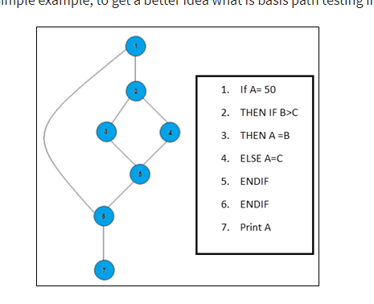
Example

Slide 41
Binary Search Flow Graph

Slide 42
Paths
Path 1: 1,2,3,5,6, 7
Path 2: 1,2,4,5,6, 7
Path 3: 1, 6, 7

Slide 43
Advantages of Basic Path Testing
It helps to reduce the redundant tests
It focuses attention on program logic
It helps facilitates analytical versus arbitrary case design
Test cases which exercise basis set will execute every statement in a program at least once

Slide 44
Load Testing
Load Testing is a non-functional software testing process in which the performance of software application is tested under a specific expected load.
It determines how the software application behaves while being accessed by multiple users simultaneously.
The goal of Load Testing is to improve performance bottlenecks and to ensure stability and smooth functioning of software application before deployment.
44

Slide 45
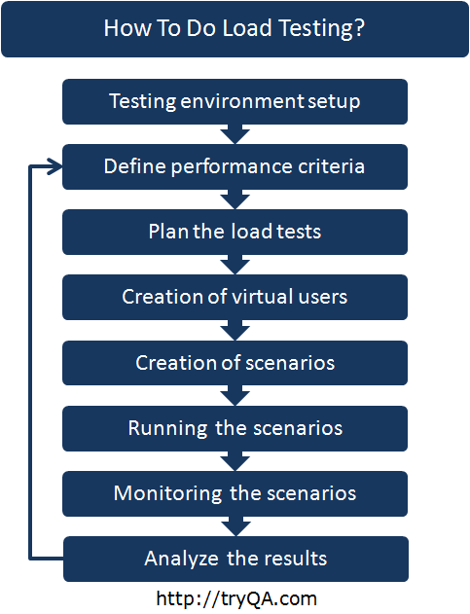
http://tryqa.com/what-is-load-testing-in-software/

Slide 46
Load Testing-Example
Target.com lost $780,000 in sales in just 3 hours when the site was down during a promotion in 2015
When Amazon.com servers crashed in 2013 for 30 minutes, Amazon lost $66,240 per minute
In Sept 2010, Virgin Blue airlines experienced a series of outages and crashes for 11 days which resulted in its checkin, online booking, reservations and boarding systems being down. This lead to a loss of $20 million in addition to thousands of frustrated customers. The company Navitaire, which managed reservation for Virgin Blue had to compensate Virgin Blue for $20milion.
46

Slide 47
Load-testing-Tool
LoadNinja
Eggplant
Load Runner:

Slide 48
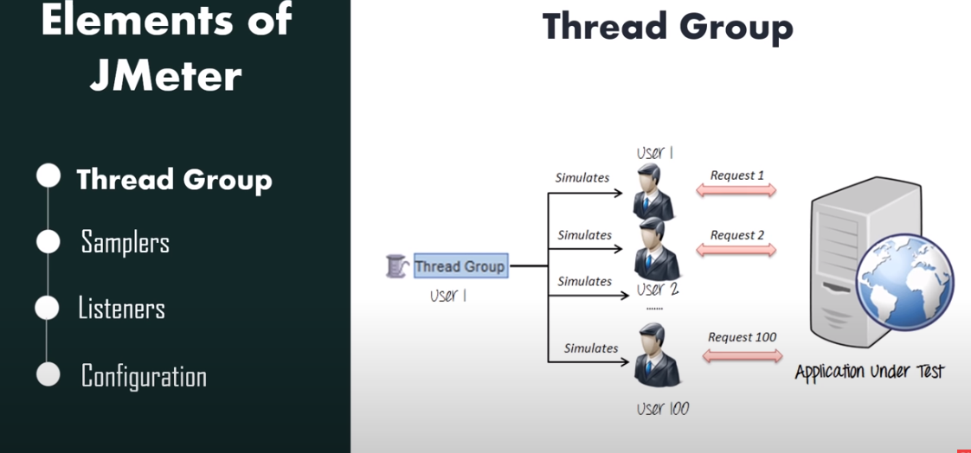
Example

Slide 49
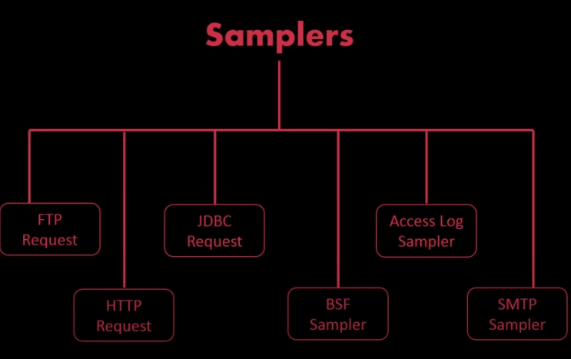

Slide 50
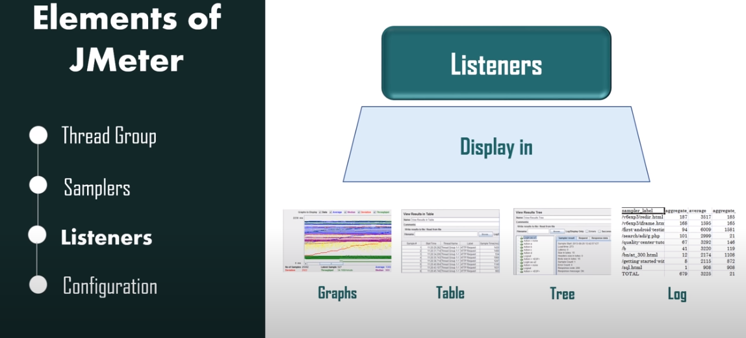

Slide 51
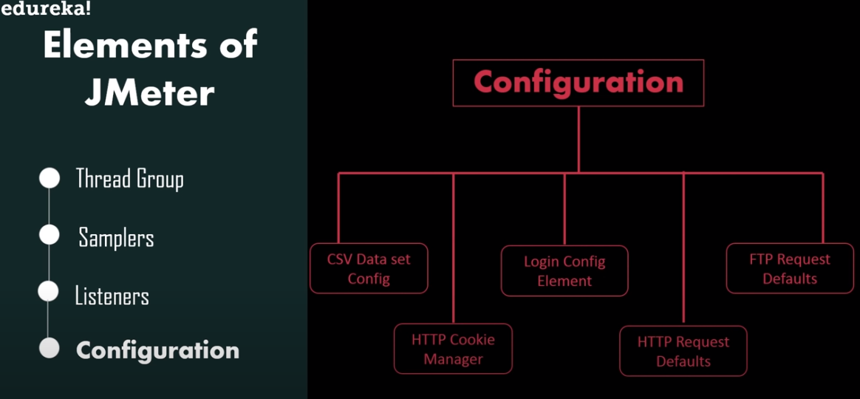

Slide 52
Stress Testing
Stress testing includes testing the behavior of a software under abnormal conditions. For example, it may include taking away some resources or applying a load beyond the actual load limit.
The aim of stress testing is to identify the breaking point.
It tests the failure behaviour of the system.
This testing can be performed by testing different scenarios such as:
Shutdown or restart of network ports randomly
Turning the database on or off
Running different processes that consume resources such as CPU, memory, server, etc.
52
Notes:
300 transactions per second; an operating system may be designed to handle up to 1,000 :;eparate terminals. Stress testing continues these tests beyond the maximum
design load of the system until the system fails. This type of testing has two functions:

